Slide 1
Introduction into language modelling
Julia Ive

Slide 2
Session Outline
Language modelling (LM) task and applications
Neural language models
Pre-processing
Training & inference
Non-causal LMs
Key Takeaways
Learning Outcomes
Familiarity with the language modelling task and types of models
Familiarity with the training and inference procedures

Slide 3
Language Models
Language is a sequence of symbols, not independent words or pairs of words
Models that assign a probability to each possible next word, given a history of words
Can be generalised for entire sentences
Can also operate at character level (or any other symbol)

Slide 4
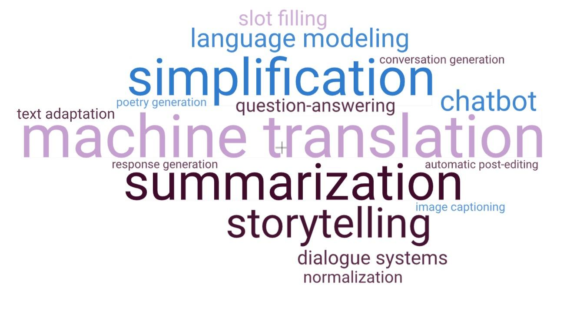
Language Models

Slide 5
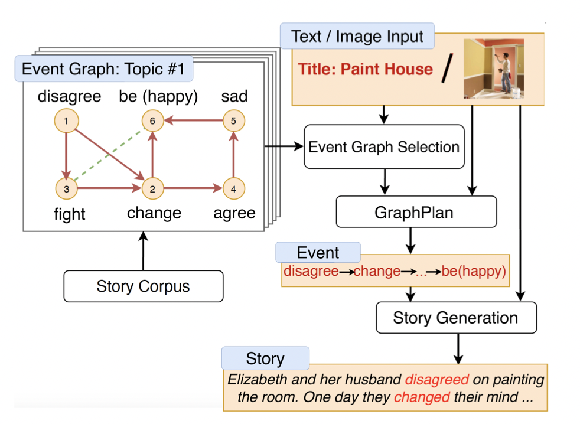
Language Models: Applications
Story Generation (Chen et al, 2021)

Slide 6
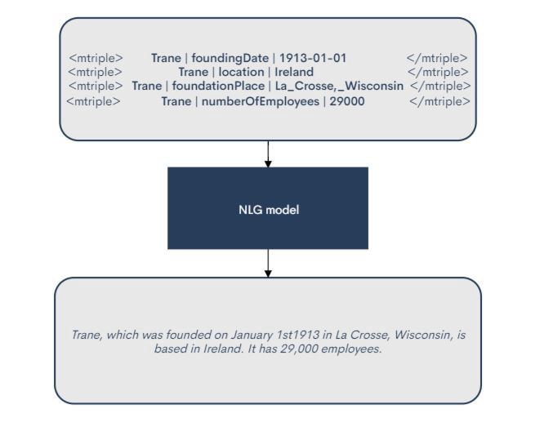
Language Models: Applications
Data2Text Generation
https://towardsdatascience.com/data-to-text-generation-with-t5-building-a-simple-yet-advanced-nlg-model-b5cce5a6df45

Slide 7
Neural Language Models
Traditional count-based (n-gram) language models take into account a limited history of words
Cannot model long-distance dependencies
No meaning representation
P(weather|she wanted to find out about the)
C(she wanted to find out about the weather)/C(she wanted to find out about the) = 0/74 = 0
NLMs map words to vectors - continuous word representations, aka embeddings
Longer history of words

Slide 8

Neural Language Models
Powerful neural network language models, including GPT, mT5, BERT and Wu Dao can produce very fluent natural language expressions
Billions of tunable parameters (GPT-3 - 175 billion parameters)
Can produce very fluent natural language expressions
https://www.artstation.com/marketplace/p/y1oe/optimus-prime-transformer-3d-model-only

Slide 9
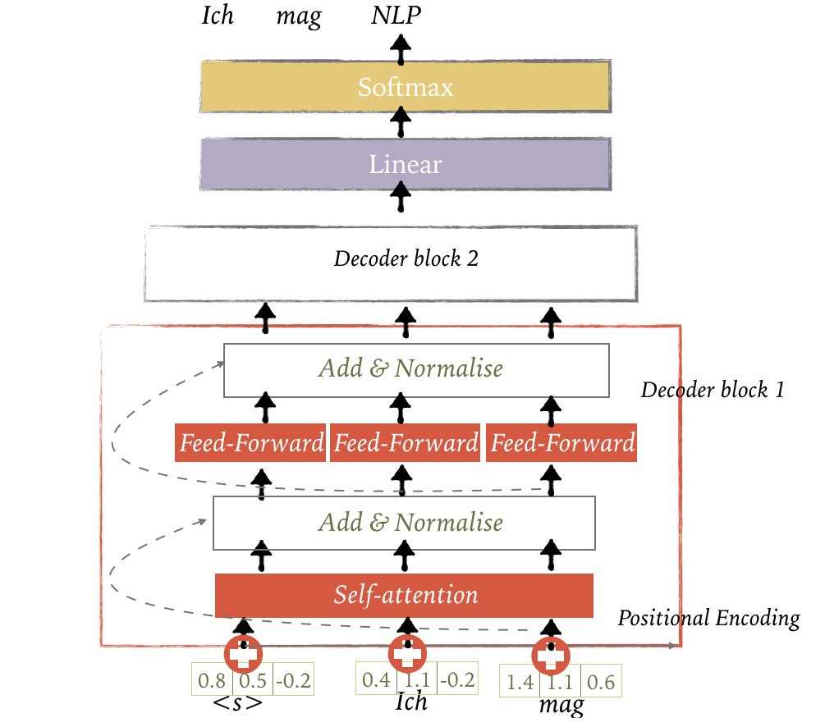
Transformer Language Model

Slide 10
Pre-processing
There are many words:
Impossible to count
~ 600K for headwords for English
Same word can have different forms
> 1M forms
connected, connecting, connection, connections → connect
How to make them recognisable by the machine?
How to make the problem computationally tractable at the prediction time?
https://en.wikipedia.org/wiki/List_of_dictionaries_by_number_of_words

Slide 11
Pre-processing
VERY important: often define the performance
Tokenisation: separate words from punctuation
dog. & dog, & dog are recognised as the same word
Normalisation: for example, lowercase
Dog & dog & DOG are the same word
All these techniques reduce the problem complexity only marginally

Slide 12
Pre-processing
Sub-word unit conversion: reduce words to subparts based on frequency to handle rare words and/or reduce vocabulary size
For example, Byte Pair Encoding (Sennrich et al. 2015)
1. Count frequency of words,
2. Segment words into chars
3. Merge 2 most frequent chars at every iteration, until a max number of merging operations

Slide 13
BPE
0. Initial vocabulary and word counts
low: 5, lower: 2, newest: 6, widest: 3
1. Add end of word marker
l o w </w>: 5, l o w e r </w>: 2, n e w e s t </w>: 6, w i d e s t </w>: 3
2. Find most frequent bigram of characters
“t” followed by “w” occurred 6 + 3 = 9 times (also possible with “e s” or “s t”)
4. Merge these two and update vocabulary
l o w </w>: 5, l o w e r </w>: 2, n e w e s t</w>: 6, w i d e s t</w>: 3
5. Repeat from step 2 for number of ‘merge’ operations (hyperparameter)

Slide 14
BPE
Iteration 1
new merge: ('t', '</w>')
vocab: {'n e w e s t</w>': 6, 'l o w e r </w>': 2, 'l o w </w>': 5, 'w i d e s t</w>': 3}
Iteration 2
new merge: ('s', 't</w>')
vocab: {'l o w e r </w>': 2, 'n e w e st</w>': 6, 'w i d e st</w>': 3, 'l o w </w>': 5}
Iteration 3
new merge: ('e', 'st</w>')
vocab: {'l o w e r </w>': 2, 'l o w </w>': 5, 'n e w est</w>': 6, 'w i d est</w>': 3}
Iteration 4
new merge: ('l', 'o')
vocab: {'w i d est</w>': 3, 'lo w </w>': 5, 'n e w est</w>': 6, 'lo w e r </w>': 2}
Iteration 5
new merge: ('lo', 'w')
vocab: {'low </w>': 5, 'low e r </w>': 2, 'n e w est</w>': 6, 'w i d est</w>': 3}

Slide 15
Training
Maximising the probability of correct (human reference) words.
Minimise the negative log likehood (NLL) of correct words:
Video from: https://lena-voita.github.io/resources/lectures/lang_models/neural/rnn_lm_training_with_target.mp4

Slide 16
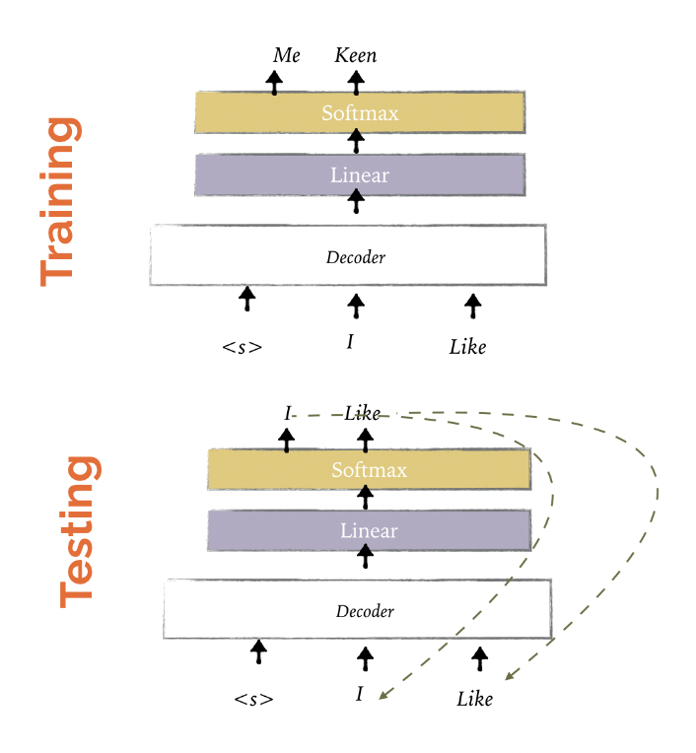
Teacher Forcing
Use the actual ground true outputs from the training dataset at the current time step t as input in the next time step t+1, rather than the output generated by the network
This makes learning faster and the model more stable.

Slide 17
Inference
Once the model is trained, how do we obtain translations?
Shortest-path in the search graph
Breadth-first search (BFS) not feasible, VT paths, T is the sequence length
Approximate search
Greedy search: Beam search with k = 1
Beam search: Prune the graph to top-k candidates at each step

Slide 18
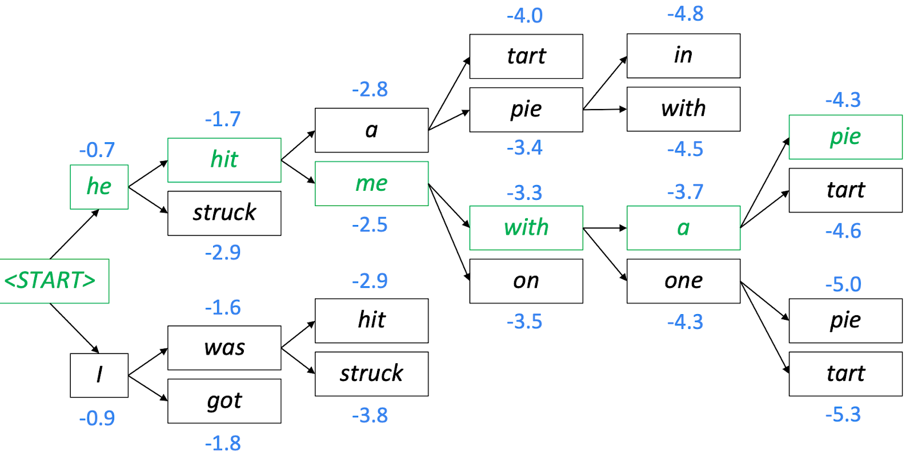
Beam Search
beam size = 2
https://web.stanford.edu/class/cs224n/slides/cs224n-2019-lecture08-nmt.pdf

Slide 19
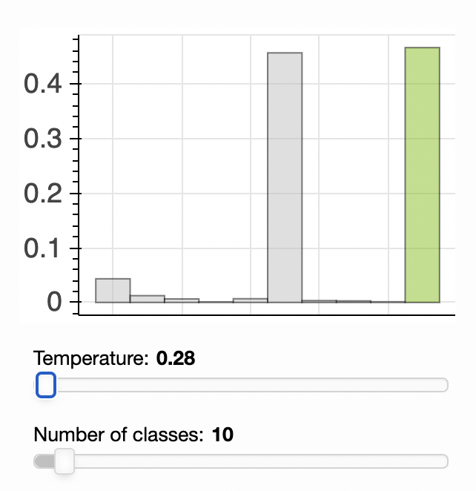
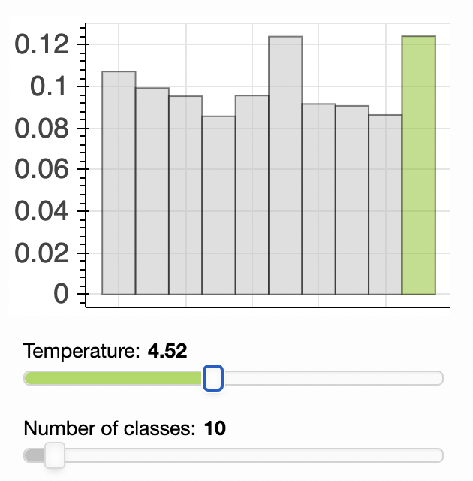
Sampling
Random sampling will choose the next token with at random from the distribution
Video: https://lena-voita.github.io/resources/lectures/lang_models/general/generation_example.mp4
Temperature sampling divides logits by the temperature before feeding them into softmax
The lower the temperature the closer the sampling procedure is to the greedy decoding
https://lena-voita.github.io/nlp_course/language_modeling.html#generation_strategies_sampling

Slide 20
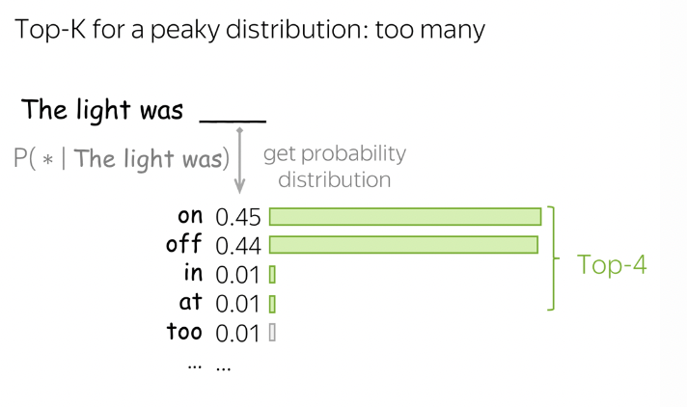
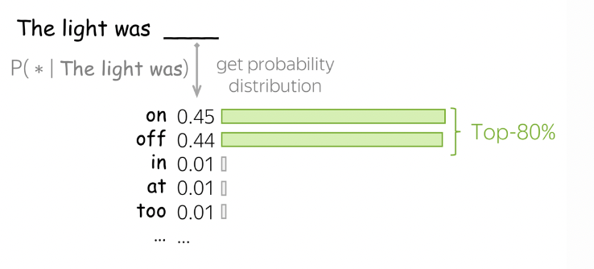
Sampling
Top k sampling takes only k most probable tokens into account and removes the distribution tail
Nucleus (Top p) sampling method chooses a set of tokens that has an accumulated probability equal or higher than a pre-defined value
https://lena-voita.github.io/nlp_course/language_modeling.html#generation_strategies_top_k

Slide 21
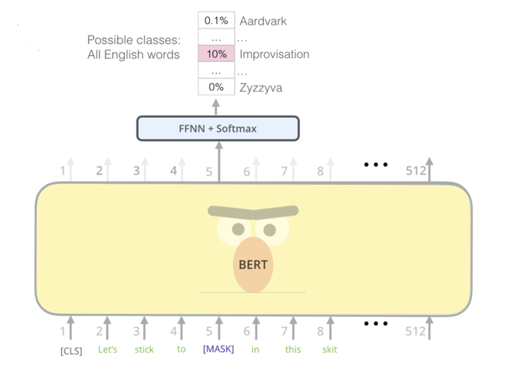
Non-causal LMs
Classical language modelling (GPT) is causal
We only consider the past when predicting the next token
Pre-trained LMs like BERT are non-causal
Both past and future are considered for contextual representations (Masked LM objective)
https://blog.tensorflow.org/2021/06/leveraging-machine-learning-pixie.html

Slide 22
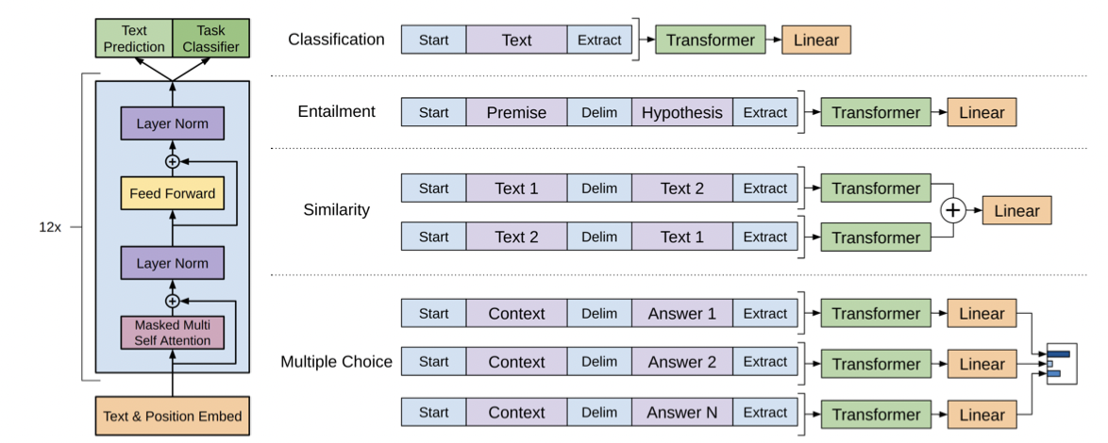
Fine-tuning of Causal LMs
(Radford et al, 2021)

Slide 23
Key Takeaways
Language models assign probabilities to words given their history
Neural language models allows to model longer contexts
Pre-processing of text is crucially important and is mainly done at the sub-word level
Language models are trained to maximise probability of the next word
Multiple decoding regimes allow to produce texts of different quality
Non-causal LMs allow to create representations of words using large pre-trained architectures, such as BERT

